Slide 1
Assistive Technologies using sensors data and producing spatial soundscape
Jhalak Dave Mtr no. 70998

Slide 2
INTRODUCTION
Introduction to ADAS: Advanced Driver Assistance Systems enhance vehicle safety and driving experiences.
Project Overview: Combining LiDAR technology with spatial audio to create a more intuitive and less visually demanding ADAS.
Objective: Enhance situational awareness and reduce cognitive load on drivers by leveraging spatial audio cues.

Slide 3
DATA
Data that has been used for analysis throughout the research is collected using lidar sensor mounted on top of a moving car.
Data size: this data has been collected over a span of 120 seconds.
GPS IMU Data
4315.387 -7951.7195 0.016249701443149966 -0.006927336546653784 0.13806357234731062 -0.35257571999999016 0.20676458000000508 9.606364020000001
latitude (ddmm.mmmm) longitude (ddmm.mmmm) angular velocity around x (rad/s) angular velocity around y (rad/s) angular velocity around z (rad/s) linear acceleration in the x direction (G) linear acceleration in the y direction (G) linear acceleration in the z direction (G)

Slide 4
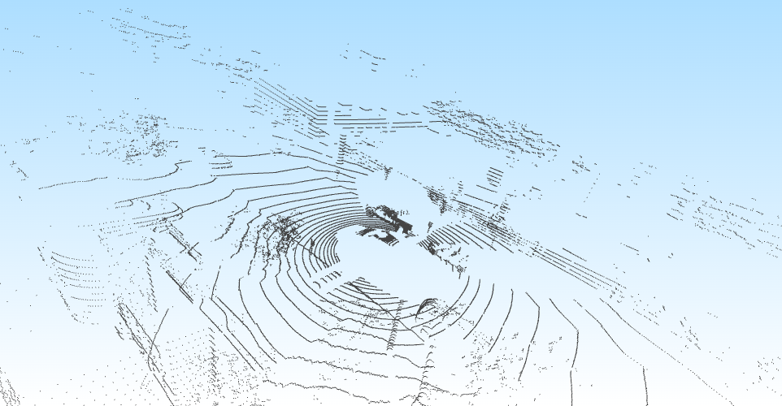
DATA
Label Data
This data has been concluded from the PCD files, where cluster of cloud points has been classified using trained data as different objects, and given attributes such as their position, rotation and scaling.
This data was useful for following the movement of objects around the subject.
{
"obj_id": "1",
"obj_type": "Truck",
"psr": {
"position": {
"x": 2.123174069920722,
"y": -4.022200008214299,
"z": -0.6255537564655307
},
"rotation": {
"x": 0,
"y": 0,
"z": -0.02617993877991509
},
"scale": {
"x": 5.584514173656585,
"y": 2.0582923876818384,
"z": 1.6567580262828112
}
Visual of a point cloud data file from the dataset

Slide 5
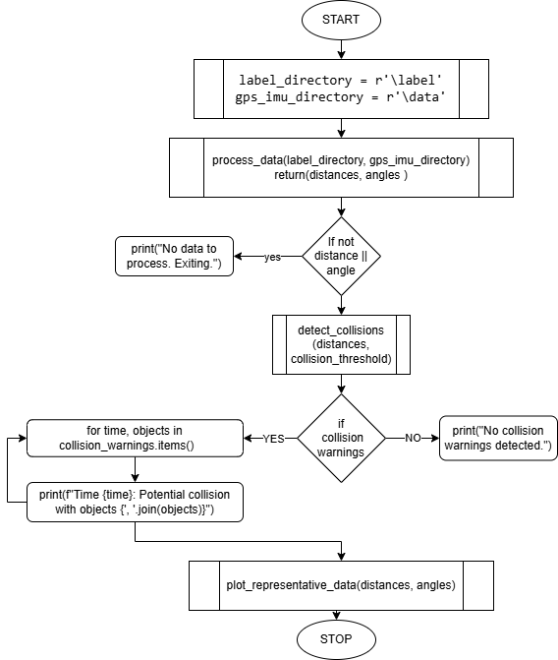
DATA PROCESSING
This is the main execution point of the driver program. It sets up the label and GPS/IMU data directories, then calls process_data to loop over the above data.
it proceeds to look for possible collisions based on a 2.0-meter threshold.

Slide 6
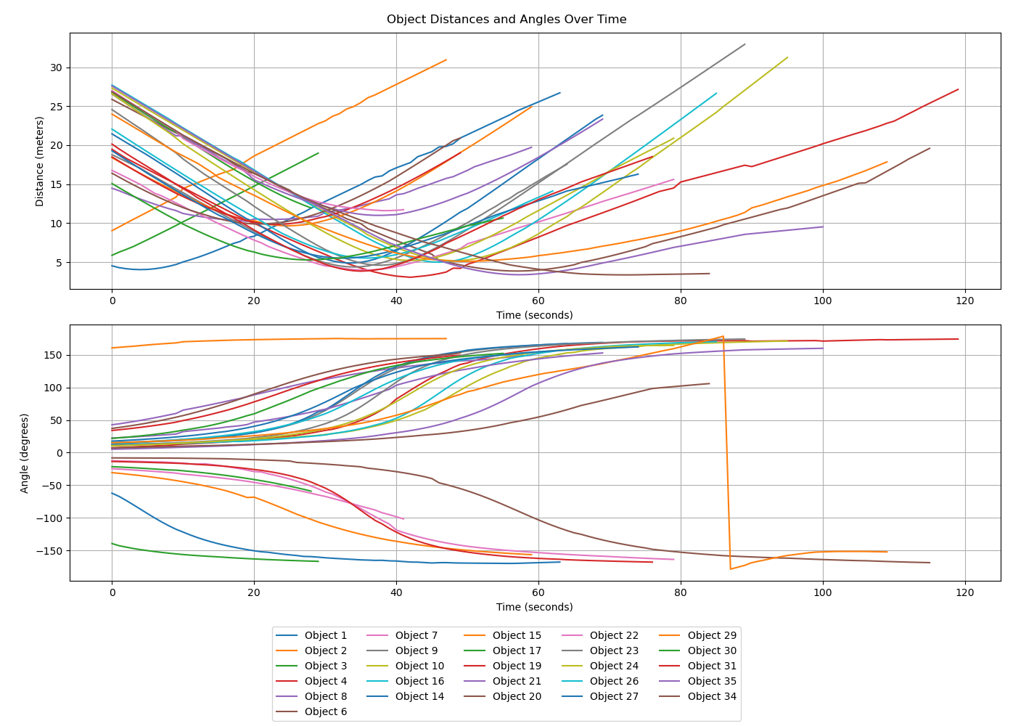
CONCLUDED RESULTS

Slide 7
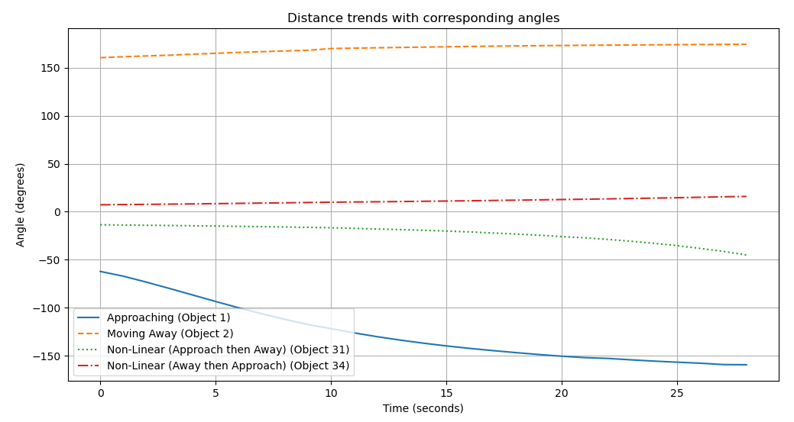
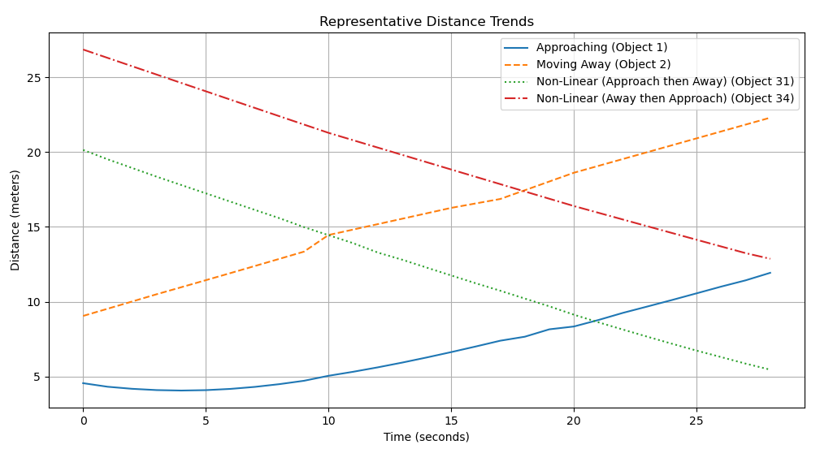
CONCLUDED RESULTS

Slide 8
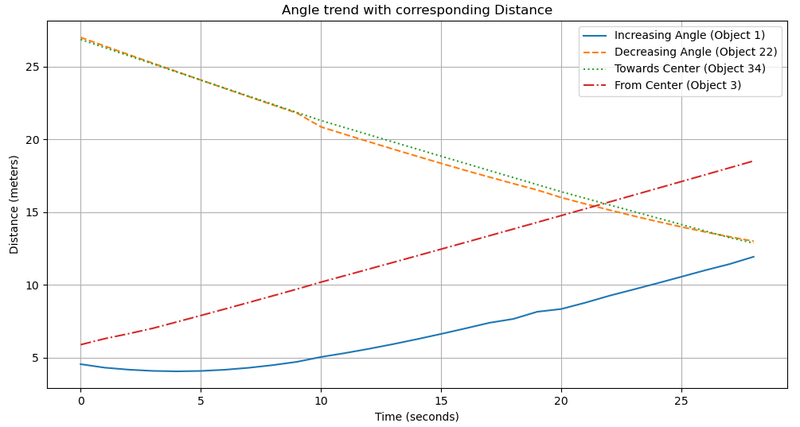
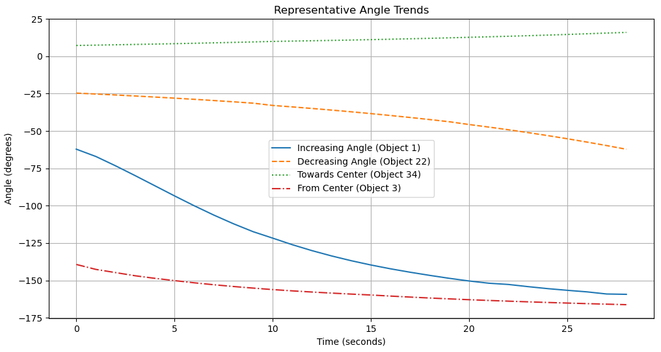
CONCLUDED RESULTS

Slide 9
CONCLUDED RESULTS
ANGLE RANGE | ANGLE CHANGE | DISTANCE CHANGE | QUADRANT | POSITION | MOVEMENT RELATIVE TO SUBJECT
0 to 90 | Increasing | Increasing | Front-Right | In front | Moving away
0 to 90 | Increasing | Decreasing | Front-Right | In front | Moving closer
0 to 90 | Decreasing | Increasing | Front-Right | In front | Moving away
0 to 90 | Decreasing | Decreasing | Front-Right | In front | Moving closer
90 to 180 | Increasing | Increasing | Back-Right | Behind | Moving away
90 to 180 | Increasing | Decreasing | Back-Right | Behind | Moving closer
90 to 180 | Decreasing | Increasing | Back-Right | Behind | Moving away
90 to 180 | Decreasing | Decreasing | Back-Right | Behind | Moving closer
180/-180 to 270/-90 | Increasing | Increasing | Back-Left | Behind | Moving away
180/-180 to 270/-90 | Increasing | Decreasing | Back-Left | Behind | Moving closer
180/-180 to 270/-90 | Decreasing | Increasing | Back-Left | Behind | Moving away
180/-180 to 270/-90 | Decreasing | Decreasing | Back-Left | Behind | Moving closer
270/-90 to 360/0 | Increasing | Increasing | Front-Left | In front | Moving away
270/-90 to 360/0 | Increasing | Decreasing | Front-Left | In front | Moving closer
270/-90 to 360/0 | Decreasing | Increasing | Front-Left | In front | Moving away
270/-90 to 360/0 | Decreasing | Decreasing | Front-Left | In front | Moving closer

Slide 10
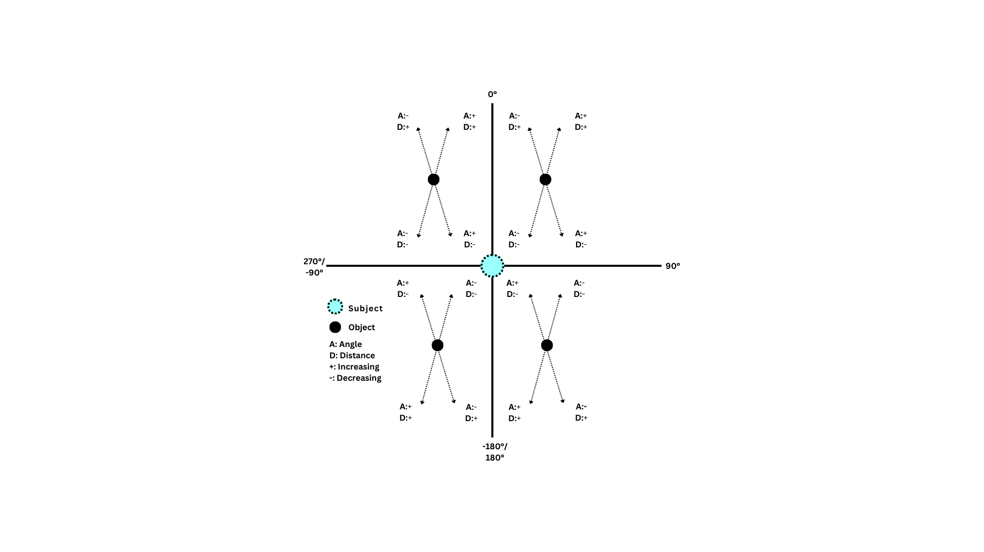
CONCLUDED RESULTS

Slide 11
THANK YOU

